Slide 1




Texts as Data I
A perspective on the analysis of legal texts
Yannis Panagis, University of Copenhagen, Faculty of Law, iCourts Centre of Excellence on International Courts
ioannis.panagis@jur.ku.dk
ypanagis

Slide 2
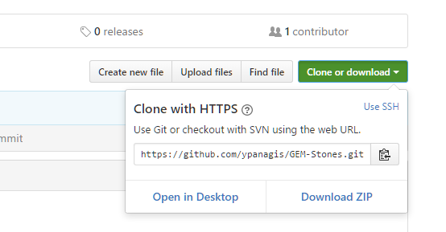
Materials
https://github.com/ypanagis/GEM-Stones

Slide 3
About me
Data expert at iCourts, Centre of Excellence for International Courts, Univ. of Copenhagen
PhD in Computer Science, 2006, Univ. of Patras, Greece
At the iCourts, since 2013
Interests:
Data Analysis
Data collection
Databases and software development
Network analysis
Natural Language Processing
Machine learning

Slide 4
iCourts
Established in 2012 from a Grundforskningsfond’s grant
28 people with different educational and national backgrounds
What role international courts play in creating, sustaining and developing the global order and how this impacts both politics and society.
Mix of qualitative and quantitative research
Interdisciplinary research (law, sociology, political, science, language, etc.)

Slide 5
The iCourts database of international courts
Established a database of int’l court decisions for 6 International Courts:
Where: http://www.icourts.dk
Included:
Court of Justice of the European Union
European Court of Human Rights
World Trade Organization – Appellate Body
International Criminal Tribunal for the Former Yugoslavia
East African Court of Justice
Inter-American Court of Human Rights
Pending:
International Criminal Court
International Court of Justice
Integrates datasets, decisions and networks

Slide 6
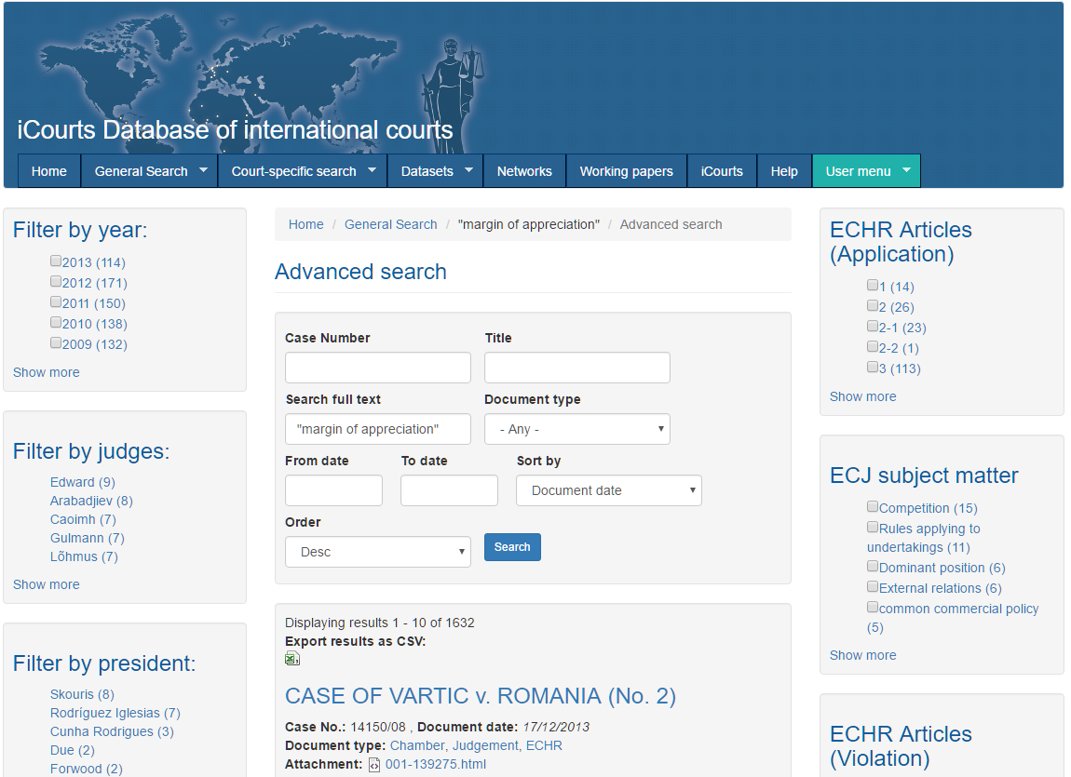

Slide 7
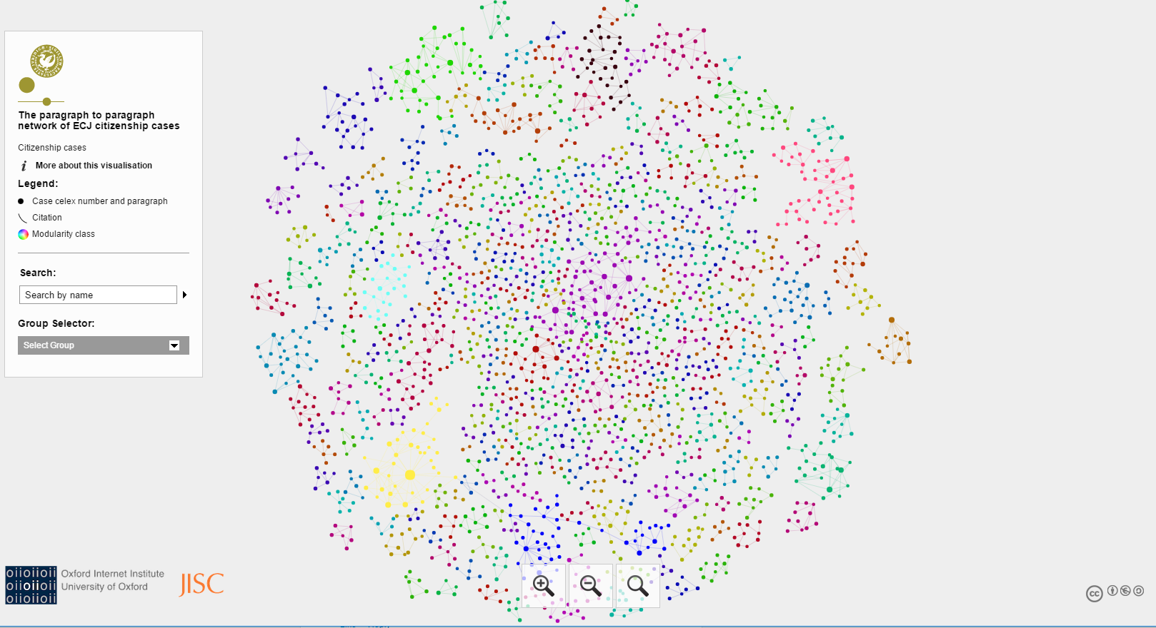
https://www.icourts.dk/networks/sigma/citizenship/

Slide 8
Talk layout
Data and how to grab them
Courts
Available text formats
Techniques and tools to collect data
Data organization and preprocessing
Some practices we use to organize our data
Text extraction and preprocessing of textual data
Text-driven research
Corpus-driven research
Paragraph to paragraph citations
Topic modeling
Practical examples
Notes:
After that Go to mentimeter.com to present the first question

Slide 9
Talk layout
Data and how to grab them
Courts
Available text formats
Techniques and tools to collect data
Data organization and processing
Some practices we use to organize our data
Text extraction and preprocessing of textual data
Text-driven research
Corpus-driven research
Paragraph to paragraph citations
Topic modeling
Practical examples

Slide 10






Legal textual data
A few years back
Subscription services
Open services
Meta search engines

Slide 11
The databases of various international courts
Court of Justice of the EU (http://eur-lex.europa.eu/)
Some might know CURIA (good but a data collection hassle)
Good interface
Good search capabilities
Decisions available in HTML and PDF (even the old) and in many EU languages
Metadata
European Court of Human Rights (http://hudoc.echr.coe.int/)
Nice search interface lots of filters and search options
Rich metadata
Decisions available in English and French (mainly)
Formats: html, MS Word, pdf

Slide 12
The databases of various international courts
International Criminal Tribunals for the former Yugoslavia and Rwanda – ICTY/ICTR (http://www.icty.org/action/cases/4 )
The provide a list of cases and relevant rulings for each
Judgments are always in pdf (and with many errors in Slavic names the early ones)
The court has a less known searchable database http://icr.icty.org/.
Needs an account (free) and difficult to scrape.
Otherwise full text seach even in scanned documents
International Criminal Court(https://www.legal-tools.org/)
You can basically browse all the cases also from ICTY/ICTR
Rich metadata (dates not always correct!)
Formats: html, pdf
Search leads to a search engine where you can perform searches (not on scanned documents, though)

Slide 13
The databases of various international courts
International Court of Justice (http://www.icj-cij.org/)
No searchable database here
The court provides list of judgments for all cases
Judgments in PDF and in many older cases one page in English and one in French!
Limited metadata
World Trade Organisation
Has both a list of disputes and a search engine, http://bit.ly/2jHKN8w
Available for the appellate body, too
Good metadata
Documents available in PDF
Provide other data such as meeting minutes through https://docs.wto.org/
http://www.worldtradelaw.net/ also provides an up to date list of awards

Slide 14
The databases of various international courts
Interamerican Court on Human Rights (http://bit.ly/1ssh6J6)
Pros:
Searchable database (title, date, type of decisions)
Judgments in PDF and Word
Available in Spanish and English
Cons:
Limited metadata, mostly have to be extracted
Incosistencies
Hard to link cases and case documents
No full text search

Slide 15
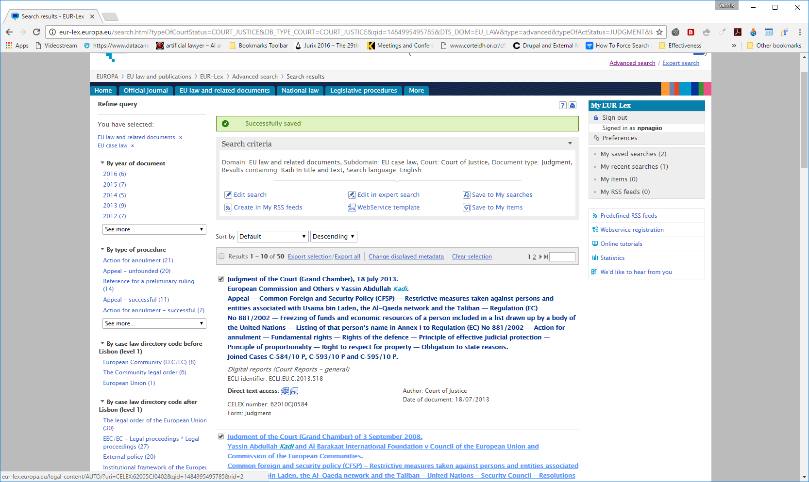
Collecting data – The anatomy of EUR-Lex
Let’s search for Kadi in text and title and court of Justice (http://bit.ly/2iMIx05)
The address
Direct link to the html
CELEX
Some useful meta
Notes:
Let’s see an example of how to collect data by looking at the anatomy of EUR-Lex. So here is a search results by searching for Kadi
The address is a critical part for reasons we will see in a few moments

Slide 16
Disecting the address part
http://eur-lex.europa.eu/search.html?typeOfCourtStatus=COURT_JUSTICE&DB_TYPE_COURT=COURT_JUSTICE&qid=1485255463974&DTS_DOM=EU_LAW&type=advanced&typeOfActStatus=JUDGMENT&lang=en&page=1&textScope0=ti-te&DB_TYPE_OF_ACT=judgment&CASE_LAW_SUMMARY=false&andText0=Kadi&SUBDOM_INIT=EU_CASE_LAW&DTS_SUBDOM=EU_CASE_LAW
Weird incomprehensive string but…
andText0=Kadi contains the search keyword!
Will it still work if we write something in double-quotes?
andText0=“european citizenship” or even better andText0=%22european%20citizenship%22 will search for “european citizenship” !!!
Proof
Idea: We can write a program to search for us by fooling the addresses!
BUT we can do things without writing code!

Slide 17
CELEX numbers
The CELEX number is a unique identifier that identifies every document of the EU including Treaties, Legislation and case law.
For the case law it encodes the case number / year
61964CJ0006 is case C-6/64, i.e. Costa v Enel
CELEX is our best friend for data collection and data analysis!

Slide 18
CELEX and direct access to judgment text
Address of the text of Costa:
http://eur-lex.europa.eu/legal-content/EN/TXT/HTML/?uri=CELEX:61964CJ0006
NB: CELEX is at the last part!
If we substitute on the last part the CELEX of Kadi 62005CJ0402 do we get the Kadi judgment?
Demo

Slide 19
Strategy to collect our judgments from EUR-Lex
Submit a query to EUR-Lex, e.g. all judgments from a period, judments containing a phrase etc.
Collect all the CELEX numbers of the texts
Find a way to download the HTML texts

Slide 20
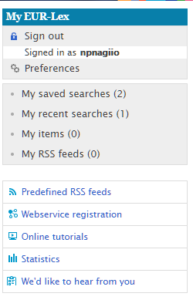
Querying
Through the query interface
By modifying the query address and run the query with a script (program)
By using the XML webservice of EUR-Lex
Options 2 and 3 may require some programming

Slide 21
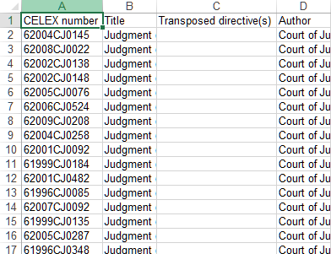
Collect CELEX numbers
Export all results (max. 100)
Scrape them
Chrome WebScraper (http://webscraper.io/) or similar
Custom scraping script

Slide 22
Question
How have you been collecting your texts?

Slide 23
Download judgments
Need to know the exact addresses
Use the CELEX + URL trick on each CELEX and save all the URLs to download in a single file
Write a program to loop over the URLs and get the files, OR
Use HTTrack, OR
Use the Mozilla Firefox extension DownThemAll (http://downthemall.net)

Slide 24
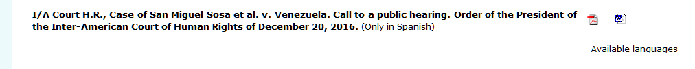
Web scraping crash course
Web is offering a lot of data but often in forms we cannot use very easily organize
Instead of:
Web scraping is the process to extract all the data that we need from sources available on the WWW
Case | Respondent | Date | Link
San Miguel Sosa et al. v. Venezuela | Venezuela | 20/12/2016 | …

Slide 25
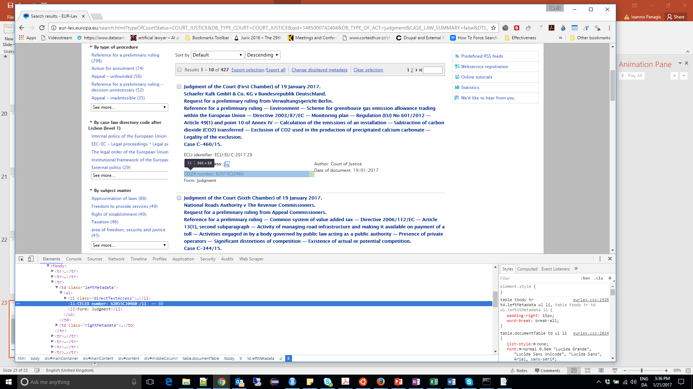
How does what you see actually look like?
Scraping:
We need a way to extract those bits as we visit the pages
HTML
Notes:
This is how it looks from the behind what you actually get to see in Chrome. I enabled the developer tools and inspected the content of the results page. What we see is the HTML commands that surround the CELEX number

Slide 26
Content selection
The way the content is organized in webpages is hierarchical
There are commands to navigate in the hierarchy and isolate certain information
Xpath and JQuery/Css selectors
NO NEED TO WRITE YOURSELVES
Chrome extensions SelectorGadget and Scraper

Slide 27
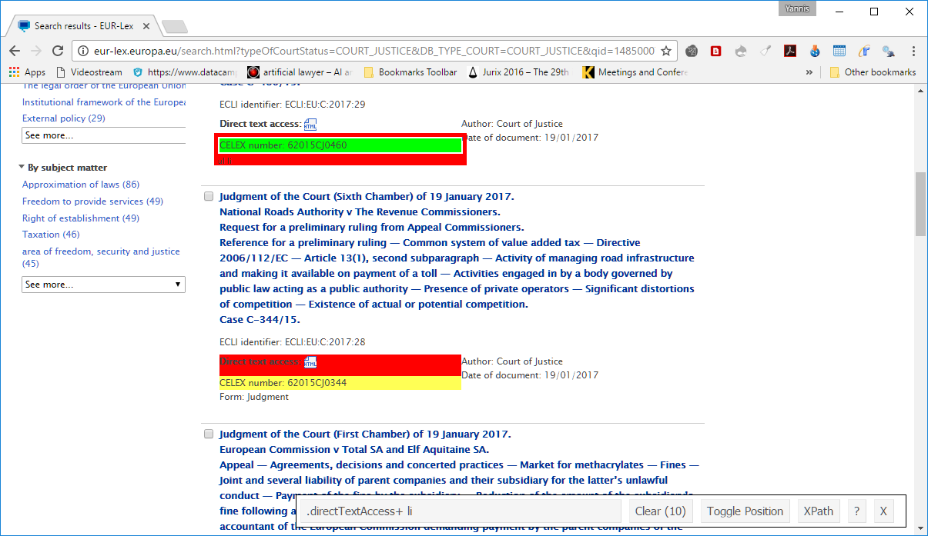
Content selection and scraping demo
Opened SelectorGadget on the results of EUR-Lex and clicked once on one CELEX number and then on the yellow areas that we don’t want to include
We then get a screen similar to that
Selector: .directTextAccess+li

Slide 28
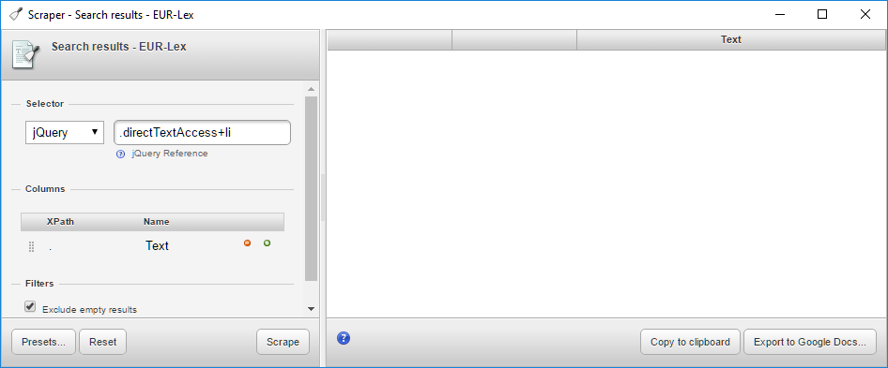
Content selection and scraping demo (2)
Right click again on a CELEX number and select Scrape similar from the menu
The Scraper screen opens
2. Paste the selector
1. Select jQuery
3. Press scrape

Slide 29
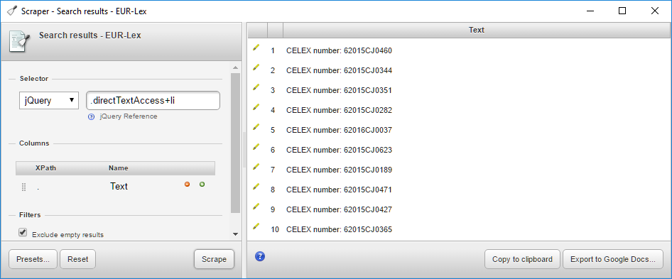
Content selection and scraping demo (3)
Voila!
If we press Copy to clipboard we can paste the CELEX numbers to Excel!
Return to the results page, move to page 2, 3, etc. and press Scrape each time
Notes:
We obviously get some extra information beyond what we want e.g. “CELEX number” string, however this can be cleaned even in Word

Slide 30
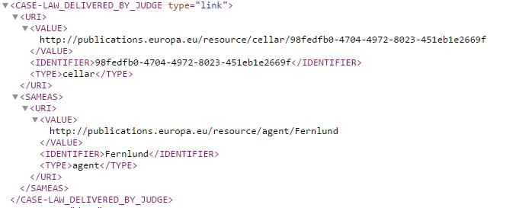
Metadata
Either scrape or
for the more advanced EUR-Lex offers XML
http://eur-lex.europa.eu/legal-content/EN/TXT/XML/?uri=CELEX:62015CJ0344
Judge rapporteur

Slide 31
General strategy for all courts/organizations
Identify which documents you need (decisions, categories, dates, etc.)
Check if you can get all data somehow
If there is a search engine:
try to fool it to bring you all the data you need
get them in small chunks
scrape what you need + download
You can go very far without writing scripts:
HTTrack (Standalone application)
DownThemAll (Firefox)
Scraper (Chrome)
Web Scraper (Chrome)
Etc.

Slide 32
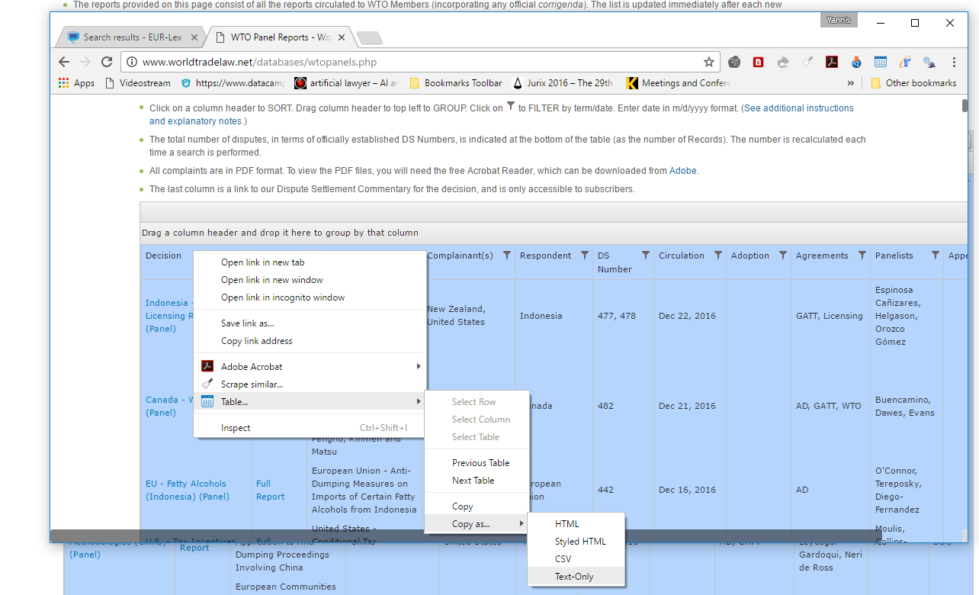
Examples of other sites
http://www.worldtradelaw.net/databases/wtopanels.php
Copytables Chrome plugin
Copy the table and paste it into Excel!
Notes:
This site has the advantage that everything is in one table thus we can copy it easily with the Copytables Chrome extension

Slide 33
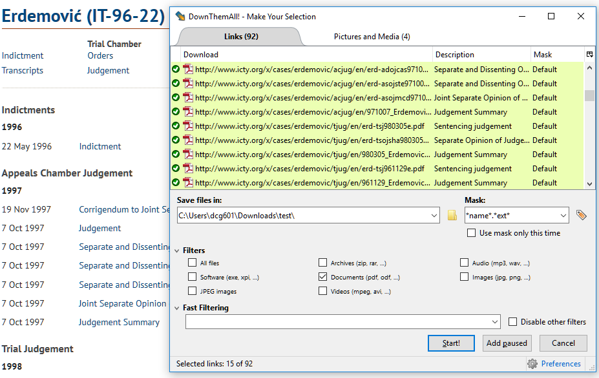
Examples of other sites (2)
ICTY, getting all texts from the Erdemovic case
We can use DownThemAll
The metadata are more difficult to get

Slide 34
Talk layout
Data and how to grab them
Courts
Available text formats
Techniques and tools to collect data
Data organization and preprocessing
Some practices we use to organize our data
Text extraction and preprocessing of textual data
Text-driven research
Corpus-driven research
Paragraph to paragraph citations
Topic modeling
Practical examples

Slide 35
Data organization
Most of the times we need a combination of textual data with our metadata to conduct an analysis
Examples:
How the average frequency of a word has changed per year
Do we observe a correlation of a word with judgments of a certain category?
Ergo: we need to establish a correspondence between texts and metadata
Two methods:
Store the text in the same dataset
Keep the texts in your hard drive but store the path in the dataset

Slide 36
Texts in the dataset
Pros:
Everything in one place
Easier to control and search
Cons:
Size: Dataset can become very large (10 years of ECHR are easily 300MB)
Readability: You cannot easily read the text itself

Slide 37
Texts separately
Pros:
Small size of the dataset
Readability: Texts are files you can open
Cons:
More effort is required to slice the dataset together with the texts
Text search is tricky
Suggestion: store in the dataset when you have relatively few texts
For the tech-savvy:
You can always use full-text search in a database engine (e.g. MySQL, Postgres, Elastic Search) and combine both approaches

Slide 38
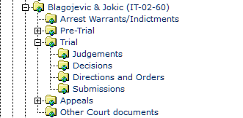
File organization
Filenames should make sense and link to the metadata
Commission.v.Denmark.html doesn’t tell us much whereas 61964CJ0006.html can tell us this is the Costa case.
Use some id or code where possible for the filename
Multiple decisions for the same case
Possible due to language versions, multiple decisions of the same case, etc.
Organize either by encoding extra info in the filename or by separate directories
In some cases the organization has a different id per document (ECLI or document id in HUDOC)
Notes:
Whenever we download a file either semi-automatically or through a script we need to make sure the filenames have some correspondence to the other data.
It is usually a good idea to use an id for the filename
With many versions for the same judgment or chamber/grand chamber there might be name collisions. Resolve either by suffix or by directory

Slide 39
Question
How do you or would you construct your dataset in the case you have many documents from the same case

Slide 40
Talk layout
Data and how to grab them
Courts
Available text formats
Techniques and tools to collect data
Data organization and processing
Some practices we use to organize our data
Text extraction and preprocessing of textual data
Text-driven research
Corpus-driven research
Paragraph to paragraph citations
Topic modeling
Practical examples

Slide 41
Content extraction
HTML, Word and PDF are not texts!
In most of the cases we need to extract the text from them to make it processable
Why not keeping the HTML?
One size fits all solution: Apache Tika
A library to convert from any format into text
Needs Java to run
java -jar tika-app-1.14.jar -t -i <input_folder> -o <output_folder>
Important!!! Use always Unicode (UTF-8) for your texts.
Hint: If you store texts and data in a single file, preprocess files to remove newlines

Slide 42
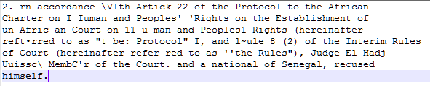
Scanned files
Unfortunately this is always a problem
Need to use a program to OCR
Lengthy procedure
Spelling errors
Known software
ABBYY
Adobe Acrobat Pro
Tesseract

Slide 43
Question
What do you expect quantitative text analysis to help you with?

Slide 44
Talk layout
Data and how to grab them
Courts
Available text formats
Techniques and tools to collect data
Data organization and processing
Some practices we use to organize our data
Text extraction and preprocessing of textual data
Text-driven research
Corpus-driven research
Topic modeling
Text network
Practical examples

Slide 45
Text-driven research
Potential uses:
Case law: Use language and texts as a tool to interpret doctrines
Construct and/or test hypotheses with the use of language.
Check the change in concepts through time
Compare concepts
See words that come up or vanish
See topics that are discussed in the texts
Many more
Notes:
Doctrine examples:
Margin of appreciation
Supremacy
Direct effect

Slide 46
Corpus - driven research
Corpus is a collection of texts
Corpus linguistics use corpora to study language
Statistical properties of word frequencies are calculated to infer statistically significant properties of words, (co-occurrence, keyness, relative frequency)
Requirements:
Texts: .txt format, preferably Unicode, preferably organized appropriately
Metadata: Might be used to slice the corpus, correlations etc.
Software tools: AntConc, SketchEngine, Wmatrix, etc.
Libraries: NLTK (Python), quanteda (R), etc.

Slide 47
Concordances
Starting with a word or phrase in mind we can see what are all the possible contexts of the word.
Usually, used to see the possible different meanings of the words
Another way of performing text searches

Slide 48
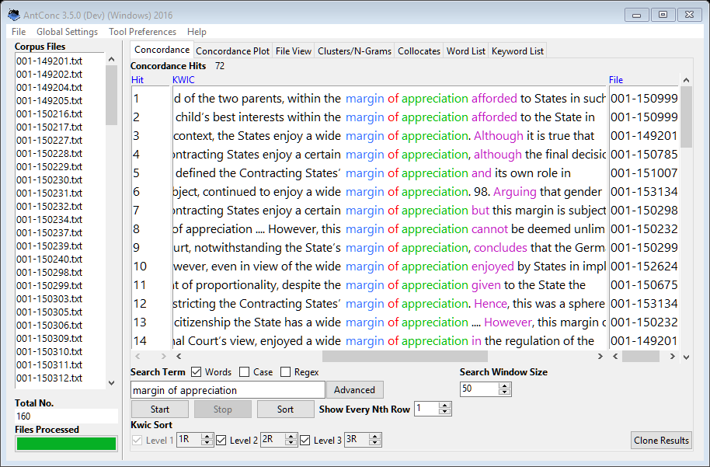
Concordances - example
Generate the concordances of the term “margin of appreciation” in a set of judgments from ECHR
Contexts
Can also be saved to a file e.g. CSV for processing
Search phrase

Slide 49
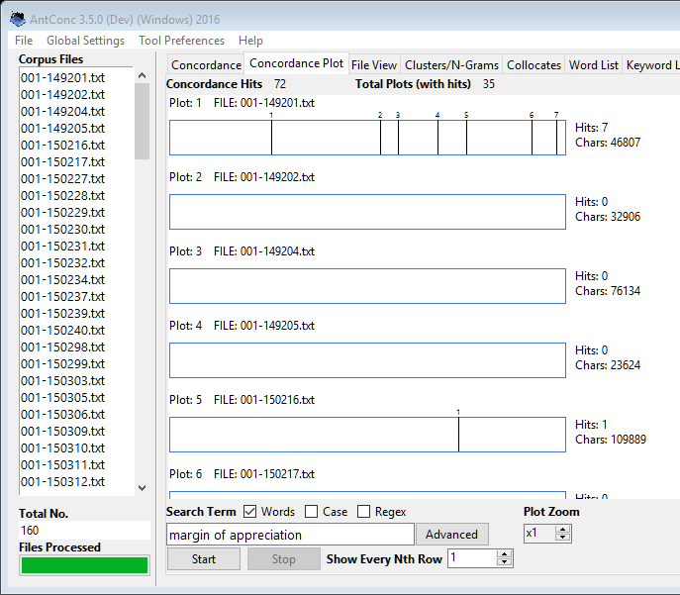
Concordances – example (2)
Concordance plot
Will graphically illustrate positions of the texts where the search term occurs
In the example above the “margin of appreciation” appeared many times in the first file which might tell something about the court argumentation in the cases

Slide 50
Collocations
Collocations show the words that often appear together in pairs…
…and with certain statistical significance
Examples:
New York
strong coffee (but NOT powerful coffee)
European Union and also Trade Union
Human Rights
Etc.
Collocation finding is a variant of hypothesis testing: We test the hypothesis that there is no association between the words beyond chance occurrences (Manning & Schutze, 1999)

Slide 51
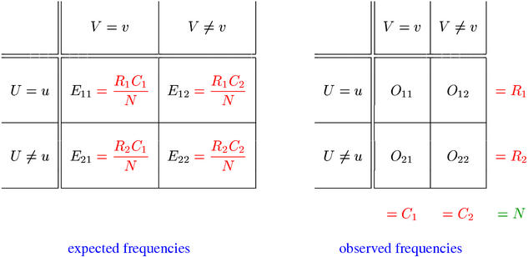
Collocations(2)
Source: http://www.collocations.de/
It is all expressed by contingency tables, above example for occurrences of words u,v
Measures:
t-score
chi-square (χ²)
Log Likelihood
MI score (Mutual Information)
Dice and logDice
Statistical importance
Exclusivity of mutual appearance
Notes:
Right Table has observed appearances
O11 number of common appearances, O12 appearances of u without v
O21 appearances of v without u, O22 appearances of other words
Left table the expeced appearances
The statistical importance measures show the statistical strength of those collocation. You can find more details in statistical hypothesis testing.
A note on the measures:
T-score and Chi-square measure generally the statistical importance of a collocation. The critical value for chi-square is 3.8 for p=0.05. The critical value for t is 2.5
MI score is more about how exclusive this collocation is. E.g. Margin is almost only with appreciation. If another indicator like t-score is not high, we cannot accept it as a frequent collocation

Slide 52
Variations
One can compute the metrics for every pair of consecutive words, OR
Query a specific word and then check the score
The software tools generally compute the scores allowing a gap between words
Allows finding collocations like ”knock” when you search for ”door” (often we have ”knock the door”), ”joint” when we search for ”enterprise” in the ICTY where we have ”joint criminal enterprise”
Often define a minimum frequency threshold

Slide 53
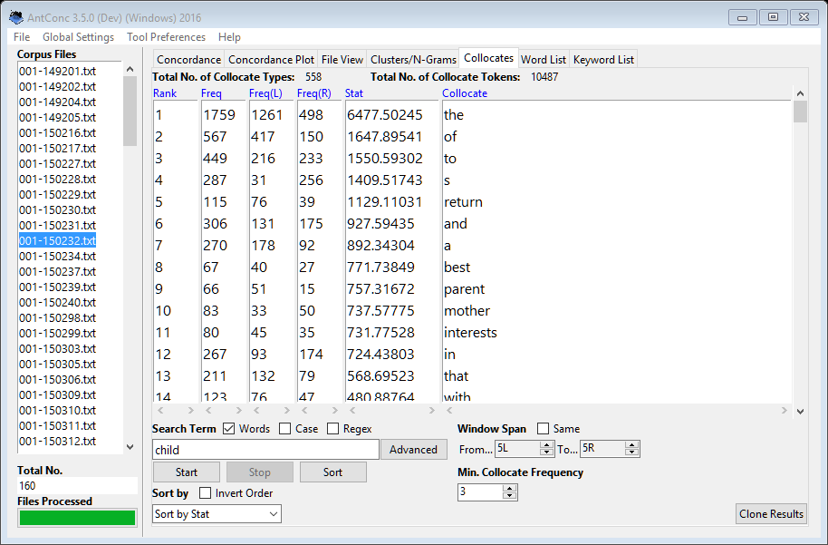
Example – log likelihood
”return” ranks high. ”return of a child” in our corpus
Include 5 words to the left and 5 to the right
Searching child

Slide 54
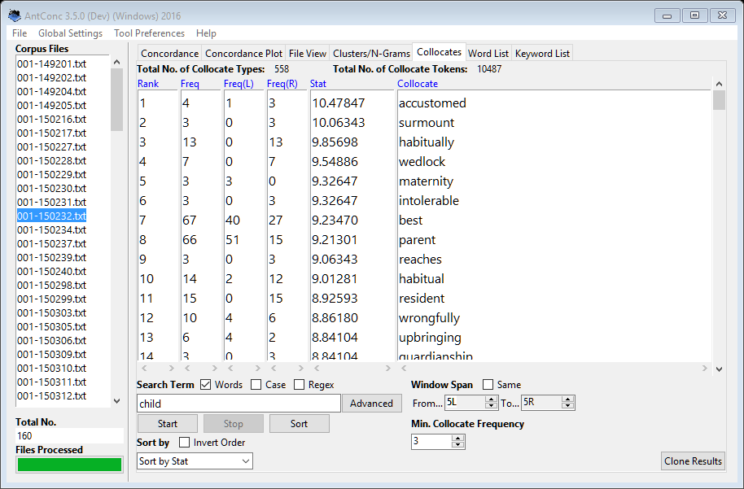
Example – MI score
”Child who was habitually resident”

Slide 55
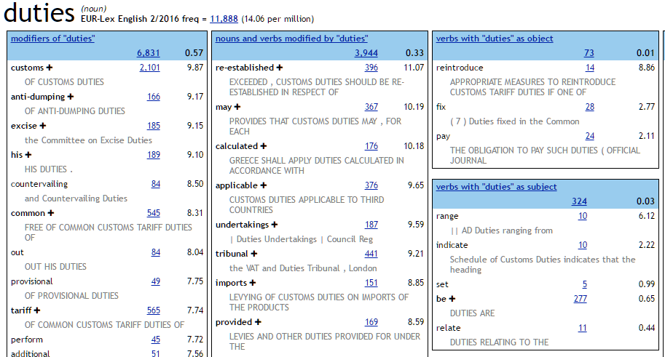
Word sketches
A concept developed by the SketchEngine software
Informally: collocations based on syntactical patterns
Principle of + noun
Verb + article + principle
Notes:
Here we are interested not in every collocation but in collocations that follow some syntactical or grammatical rules (examples in the slide)
e.g. we want principle of something, to examine which principles are developed in our texts
Or which verbs e.g. obey the principle, follow the principle etc.

Slide 56
Comparative techniques
Compare the behavior of a corpus against a reference corpus.
Can be judgments v. general corpus or 2010s v. 2000s or appeal v. trial, etc.
Study how concepts change
Examples:
Terms unusually frequent in one corpus vs. the other (keyness)
SketchDiff: SketchEngine’s concept to show how WordSketches differ
Relative frequencies: compare the relative frequency of terms

Slide 57
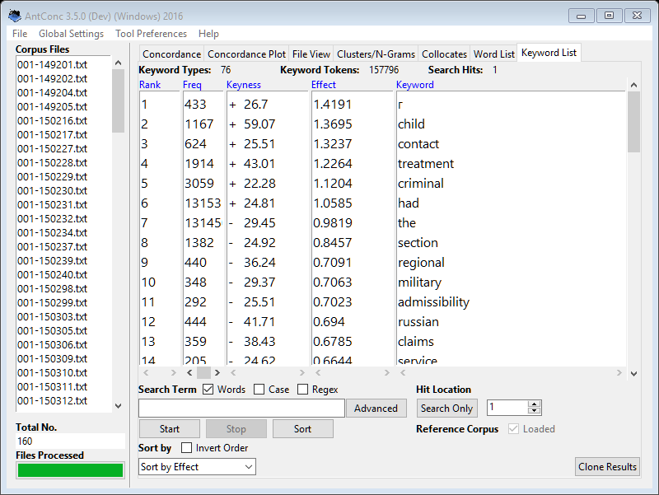
Keyness
Given a set of files we want to examine and a reference corpus we can find the keyness, i.e. terms with unusual high occurrences in our set
Examined two set of ECHR judgments from different years
high keyness
Child
Treatment
Criminal
Lower keyness
Regional
Military
admissibility
Notes:
High keyness mean that child is far more important in the corpus we see than in the corpus we compare with
Lower keyness, words from the reference corpus

Slide 58
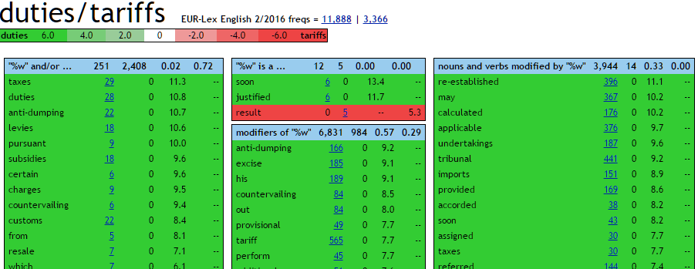
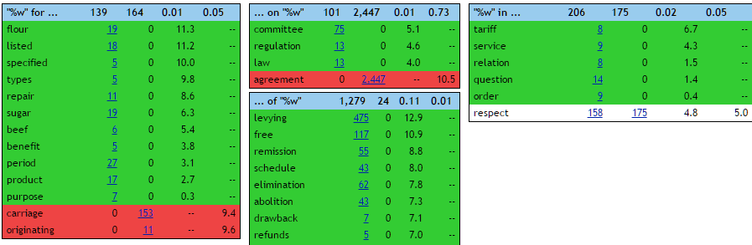
SketchDiff
“Anti-dumping” or “excise“ duties
Duties v. Tarriffs in EUR-Lex
Committee on duties and agreement on tariffs

Slide 59
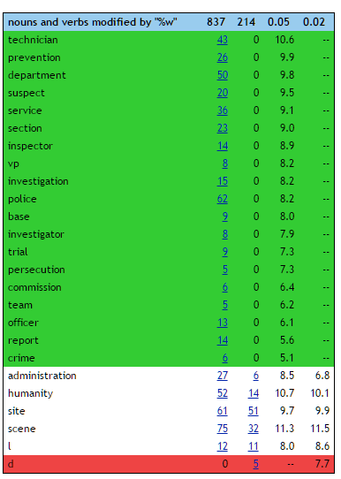
SketchDiff (2)
Crime in Trial v. Appeals in ICTY
“crime prevention” is mentioned a few times in appeals chamber
“crime police” is mentioned a few times in appeals chamber
“humanity” in both because of “crimes against humanity”

Slide 60

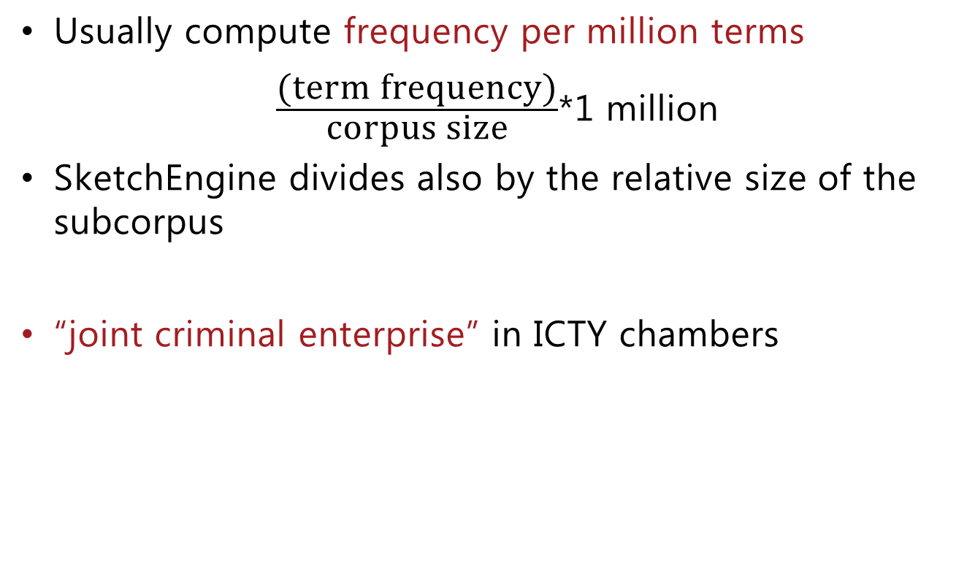
Relative frequencies
Usually compute frequency per million terms
$\frac{\text{(}\text{term} \text{frequency}\text{)}}{\text{corpus} \text{size}}$*1 million
SketchEngine divides also by the relative size of the subcorpus
“joint criminal enterprise” in ICTY chambers
Notes:
For the SketchEngine example go to SketchEngine and search “joint criminal enterprise” in the entire corpus and then click Frequency on the left and select document.type

Slide 61
Talk layout
Data and how to grab them
Courts
Available text formats
Techniques and tools to collect data
Data organization and processing
Some practices we use to organize our data
Text extraction and preprocessing of textual data
Text-driven research
Corpus-driven research
Topic modeling
Text network
Practical examples

Slide 62
Topic modeling
Given a document corpus, topic modeling studies different ways to infer the topics present in the corpus
Uses of topic modeling :
What topics is each document about
how topics develop over time
Prominent topics in a collection of documents
How topics are correlating to other variables like year, period, category, etc.
Requirements:
Texts: Same as with corpus-driven analysis. Sometimes good to have them in a dataset
Software: MALLET
Libraries: MALLET (Java), gensim (python), STM (R), topicmodels (R)

Slide 63
Anatomy of topic models
Topic modelling is a variant of unsupervised machine learning: The computer tries to infer the topics from the texts without training.
The topics are composed of words and for each word we have the probability that it characterizes the topic
Some topics from a topic model about effectiveness in the ECHR
topic. 1 | remedy | case | appeal | applicant | article | court
weights. 1 | 0.045 | 0.031 | 0.031 | 0.027 | 0.021 | 0.021
topic. 2 | medical | cases | treatment | availability | system | international
weights. 2 | 0.018 | 0.015 | 0.015 | 0.011 | 0.009 | 0.008
topic. 3 | authorities | procedure | criminal | review | fair | judicial
weights. 3 | 0.019 | 0.019 | 0.017 | 0.016 | 0.015 | 0.015
topic. 4 | court | domestic | convention | remedy | question | compensation
weights. 4 | 0.037 | 0.033 | 0.027 | 0.026 | 0.014 | 0.013
topic. 5 | legal | assistance | counsel | rights | series | ensure
weights. 5 | 0.029 | 0.027 | 0.023 | 0.022 | 0.021 | 0.021
topic. 6 | investigation | court | applicant | authorities | police | treatment
weights. 6 | 0.063 | 0.039 | 0.037 | 0.025 | 0.018 | 0.018
topic. 7 | investigation | case | circumstances | article | state | death
Topics have to be hand labelled. This topic is probably about (effectiveness of) investigation

Slide 64
Topic modeling – Latent Dirichlet Allocation
Latent Dirichlet Allocation (LDA), is a known method for performing topic modeling.
It gives reasonable results
It constructs a model by (http://bit.ly/2jdJAov) :
Assuming that a text is a bag-of-words
Assuming in the beginning every topic has the same probability per document and word
Iterating each document multiple times and reassigning probabilities for a document to belong to a topic and for a word to belong to the topic
This process approaches a problem that is computationally hard = difficult to solve so we solve approx
We have heuristics such as Gibbs sampling, Expectation Minimization
Notes:
LDA iterates each document multiple times. Each time:
- It estimates the probability of the word seen is about a topic
- it estimates the probability of the document seen is about a topic
This problem is computationally difficult therefore we solve it approximately

Slide 65
Topic modeling – Latent Dirichlet Allocation (2)
Inputs:
A corpus of texts
A number k, the number of topics to be estimated
Outputs:
Probabilities that a word belongs to a topic
A word can be about many topics, e.g. article, convention.
We keep the top-n, e.g. top-5 terms per topic and try to characterize it
Probabilities that a document is about a topic
A document can be a combination of many topics, each with different probability, e.g. taxation and workers

Slide 66
Example
Case 21750/04 from ECHR, where its hudoc id is 001-96869
After running a LDA on the collection the model decides the following topics:
001-96869.txt 15 0.67 0 0.12 2 0.10 …
Which means that the text is predicted to be
67% topic 15,
12% topic 0
10% topic 2
Topic numbers
Topic proportions

Slide 67
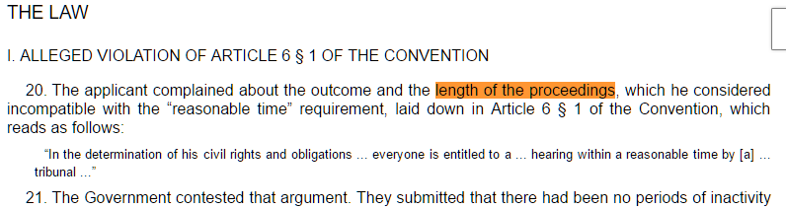
Example (contd)
Topics
Judgment excerpt:
No. | Most probable words
0 | proceedings court length applicant administrative
2 | applicants judgments appeal supervisory judgment Romania
15 | court applicant article convention case application
Notes:
Topic 15 is a rather generic procedural topic, topic 0 though is clearly about the length of proceedings

Slide 68
Number of topics and selection
The number of topics k, is a parameter we have to supply
Intuition:
Depends on the size and the diversity of the collection. Large collections will probably need larger number of topics
In practice if we choose k too large some topics seem to repeat (overfitting)
Automatic k selection:
Vary k in a range, e.g. 5..100 and keep the k that
maximizes the log-likelihood of word/topic
Maximizes topic coherence (O’ Callaghan et al., 2015)
Manual topic selection:
Choose different values of k
Examine the generated models and choose the model that best describes your collection

Slide 69
A case study: the concept of effectiveness in ECJ and ECHR
Research question: Is there a rise in neoliberal discourse from the two courts?
We limit to effectiveness since effectiveness seems to be a core neo-liberal concept and has also been increasingly used by the courts
Effectiveness of what? (Is it neoliberal?)
Data:
Collected judgments from both courts that mentioned effectiveness
Created a corpus consisting only of the concordance lines of effectiveness (captured the contexts of effectiveness)
Analysed the corpus via topic modeling and concordances

Slide 70
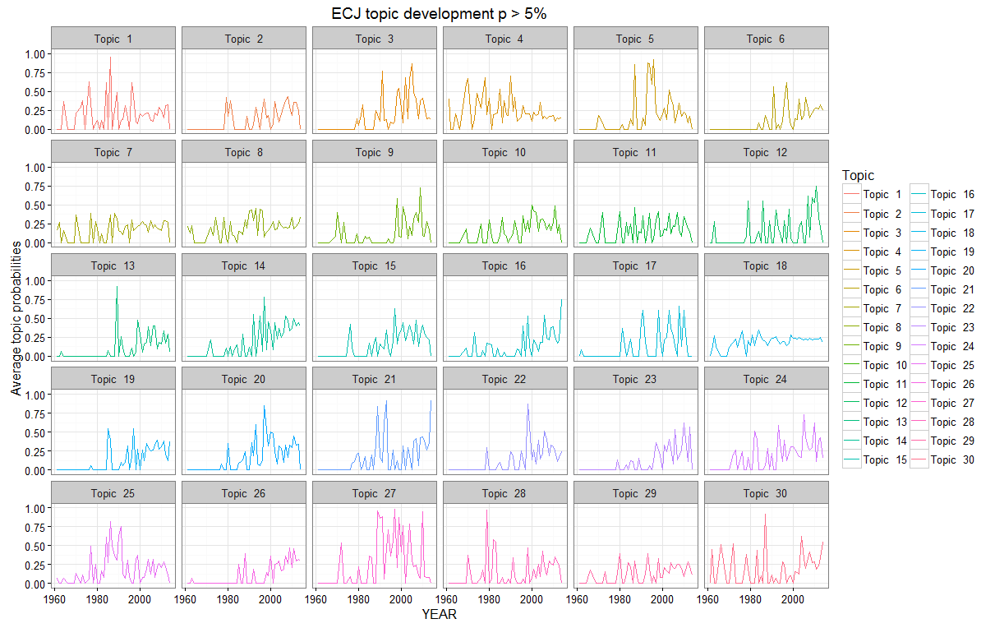
Topic development for the ECJ
Notes:
Present the average topic proportions where a topic has more than 5% in a document

Slide 71
Topic development for the ECJ
Topic 9 | measures, kingdom, united, provisions, order, countries, states, measure, council, schengen
Topic 21 | freedom, law, treatment, scheme, case, prior, justified, provisions, fundamental, legitimate
Topic 30 | market, undertakings, proceedings, insolvency, undertaking, butter, legal, efficiency, price, consumer
Kjær et al. The Use of “Effectiveness” in the Case Law of the Court of Justice of the European Union and the European Court of Human Rights, J of Lang and Law, to appear
Notes:
Lets have a look at two topics that seem to have a rise in the years after 2000 and a a topic that was also discussed in the early periods

Slide 72
Structural Topic Modeling
A variant of LDA that can take into account metadata about the texts.
Can perform regression with the topics
Requirements:
Texts: As used with LDA. Beneficial if the dataset is in a table form with some columns to contain metadata e.g. year and a column for the text
Software:
STM(R)

Slide 73
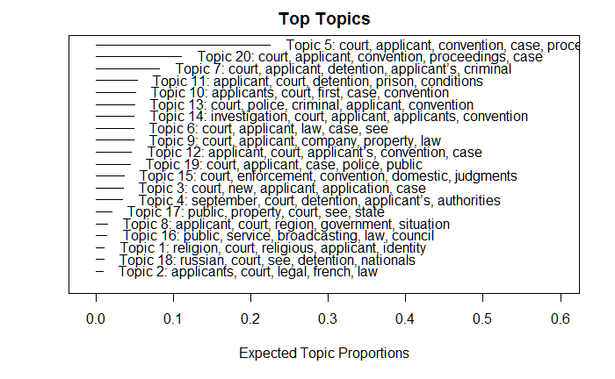
An example

Slide 74
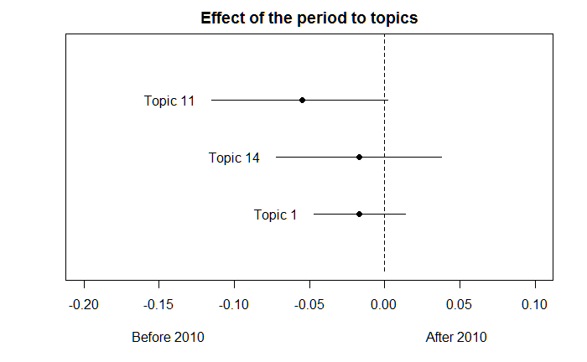
An example (2)

Slide 75
Non-negative Matrix factorization
A topic modeling variant. Uses linear algebra
It constructs a model by:
Representing the corpus as a matrix A
documents x terms
Computing an algebraic transformation of A into two matrices W and H
A = W x H
Requirements:
Texts: as before
Software: sci-py (Python), nmf (R)

Slide 76
Non-negative Matrix factorization (2)
k x m
n x m
n x k
=
x
topics
Docu-ments
terms
topics
terms
A
W
H
A: n x m
W: n x k
H: k x m
k: the number of topics for some number k s.t. k «m , e.g. 100 vs. 10.000

Slide 77
Non-negative Matrix factorization (3)
Inputs:
Text corpus represented as document-term matrix, A. Each element is the TF-IDF score (details to follow)
A number of topics k.
Outputs:
Matrix W: rows are documents, columns topics
The largest scores for each row are the most probable topics
Matrix H: rows are topics, columns are terms
The largest scores for each column are the most probable terms. We usually keep the top-n, n=5,8,10 of them

Slide 78
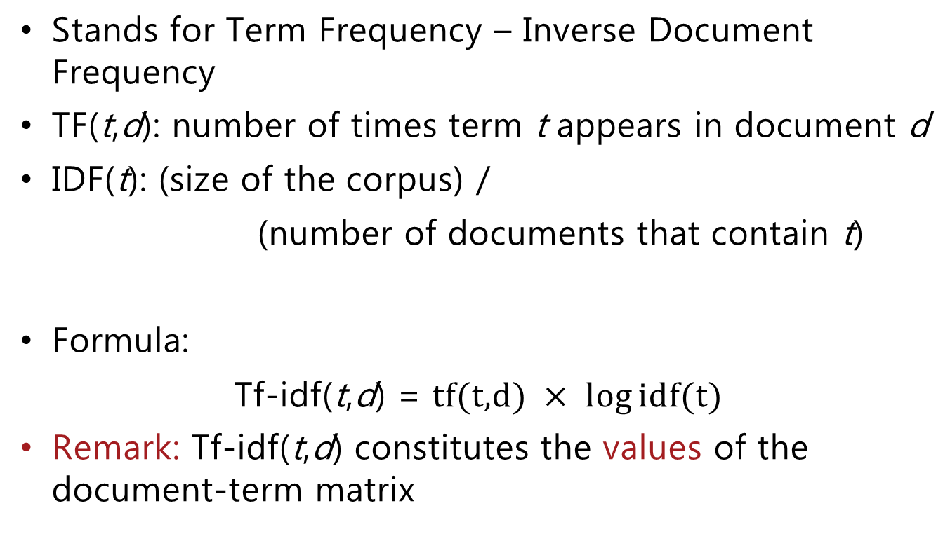
TF-IDF
Stands for Term Frequency – Inverse Document Frequency
TF(t,d): number of times term t appears in document d
IDF(t): (size of the corpus) /
(number of documents that contain t)
Formula:
Tf-idf(t,d) = $\text{tf}\text{(}\text{t}\text{,}\text{d}\text{)} × log{\text{idf}\text{(}\text{t}\text{)}}$
Remark: Tf-idf(t,d) constitutes the values of the document-term matrix

Slide 79
Talk layout
Data and how to grab them
Courts
Available text formats
Techniques and tools to collect data
Data organization and processing
Some practices we use to organize our data
Text extraction and preprocessing of textual data
Text-driven research
Corpus-driven research
Topic modeling
Text network
Practical examples

Slide 80
Texts as networks
A bit unusual but texts can be used to build networks as well
Usual suspect: Citation networks
Semantic networks:
Nodes: texts,
Edges: Undirected edge between two texts t1, t2 if similarity(t1,t2) > threshold
Similarity:
Cosine similarity (in R http://bit.ly/2jItlyk )
Jaccard
Topic similarity, etc.

Slide 81
Texts as networks (2)
Paragraph-to-paragraph network, Panagis & Sadl, JURIX 2015 (https://ssrn.com/abstract=2787119):
Research Questions:
Which are the most popular paragraphs cited in CJEU and european citizenship cases?
How is the court citing them?
Idea: Construct a network of paragraphs that cite and get cited and perform network analysis and textual analysis

Slide 82
Paragraph to paragraph network, details
Collected from EUR-Lex all judgments about European citizenship
Isolated the citing paragraphs
Needed a way to extract cited paragraphs
Could have used regular expressions
Too complicated expressions and code
Used the GATE software
Constructed rules that match paragraph citations
Added a gazetteer with all case names to find references like Grzelczyk par. 33

Slide 83
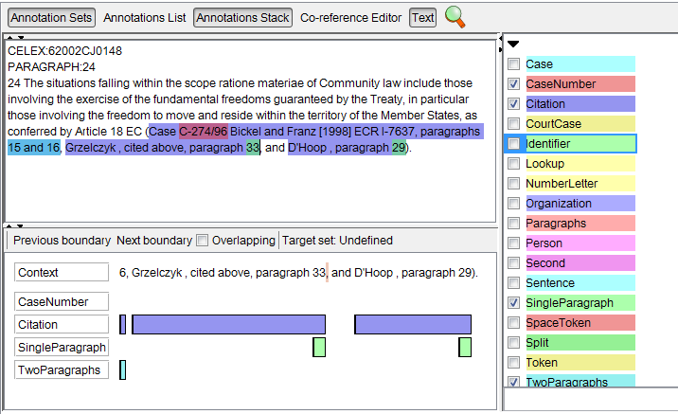
Paragraph to paragraph network, details (2)
Have case number, easier to identify
Can identify those, too

Slide 84
Paragraph to paragraph network, details (3)
The outcome is something like that which we can parse

Slide 85
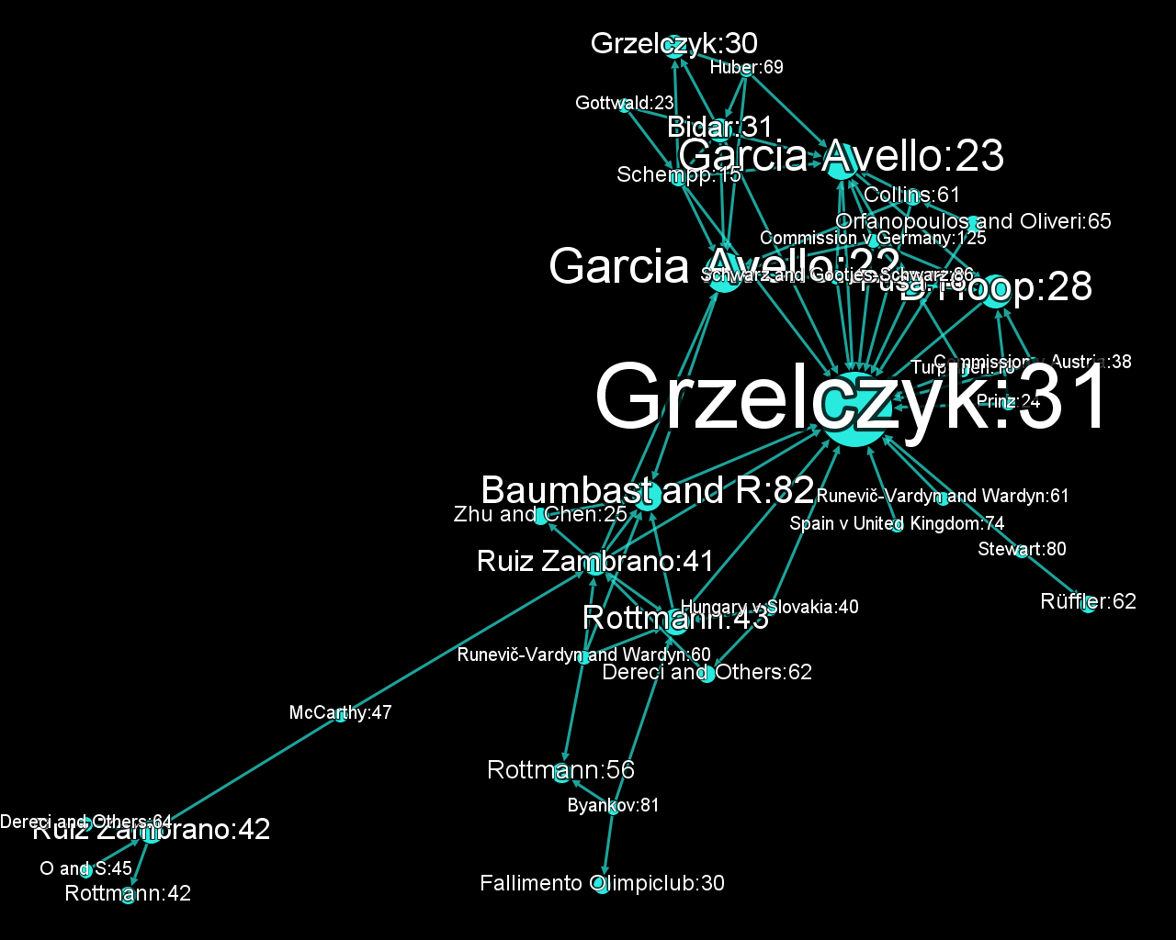
Paragraph to paragraph network, details (4)
The network is sparse, we can perform only basic network analysis.
Here we see one weakly connected component corresponding to Grzelczyk, par. 31

Slide 86
Paragraph to paragraph network, details (5)
Where to go from here:
Paragraph-to-paragraph networks should be sparse, we can only perform basic network analysis, e.g. degree centrality etc.
We can analyse though the texts of the various Weekly Connected Components and study their topics
In the paper we did so with RAKE and LDA
RAKE is a fast heuristic to extract keywords.

Slide 87
Questions difficult to answer
Is the outcome of the case pro applicant or pro defendant?
Which judgments have intervention by amicus curiae?
What is the voice of the parties saying? (especially in criminal law I believe)
Is judgment X about the Y doctrinal concept? (search migth help though)
Has the Court (ECHR) awarded ”margin of appreciation”?
And much more...

Slide 88
What was not covered
Text scaling:
Indentify political positions in texts. Uses Poisson Item-Response Theory (just quoting!)
See, i.a.:
Slapin, Jonathan, and Sven-Oliver Proksch. 2008. A scaling model for estimating time-series party positions from texts. American Journal of Political Science 52(3):705–22.
Grimmer & Stewart, Text as Data: The Promise and Pitfalls of Automatic Content Analysis Methods for Political Texts, Political Analysis (2013)
Software: wordfish (R)
Sentiment analysis:
Analyse the emotional tone in the text and use it for testing various assumptions.
Usually works with a dictionary of terms that are preclassified as positive or negative and with a score. At the end the scores are aggregated
Software: LIWC (http://liwc.net) and many others

Slide 89
References
Corpus linguistics and Natural Language Processing
Chris Manning and Hinrich Schütze, Foundations of Statistical Natural Language Processing, MIT Press. Cambridge, MA: May 1999.
Julia Silge and David Robinson, Tidy Text Mining with R, http://tidytextmining.com/
Steven Bird, Ewan Klein, and Edward Loper, Natural Language Processing with Python (http://www.nltk.org/book/) or Amazon
Topic modeling
Getting Started with Topic Modeling and MALLET
Roberts, Stewart, Tingley, and Airoldi. "The Structural Topic Model and Applied Social Science."Advances in Neural Information Processing Systems Workshop on Topic Models: Computation, Application, and Evaluation. 2013.
Derek Greene, James P. Cross , Exploring the Political Agenda of the European Parliament Using a Dynamic Topic Modeling Approach Political Analysis, 2016.

Slide 90
Software
Web scraping:
DownThemAll (Firefox)
HTTrack
Scaper (Chrome)
WebScraper (Chrome)
Corpus-based text analysis:
AntConc
SketchEngine
Topic modeling
MALLET
Other
GATE: A framework to assist Natural Language Processing tasks https://gate.ac.uk/
Stanford NLP
Rstudio: Integrated environment to write R code

Slide 91
Talk layout
Data and how to grab them
Courts
Available text formats
Techniques and tools to collect data
Data organization and processing
Some practices we use to organize our data
Text extraction and preprocessing of textual data
Text-driven research
Corpus-driven research
Topic modeling
Text network
Practical examples

Slide 92
Example 1
Download a list of URLs with DownThemAll
Notes:
Open downthemall
Press the small button (Import from file) down to the left
Select txt and open the file with the celexes
Make sure the mask is *qstring*.html
Press Start

Slide 93
Example 2
Use AntConc to run concordances, collocations, etc.
Use SketchEngine with the taxes example

Slide 94
Example 3
Walk through the Structural Topic Model example

